Slide 1
Data generation architecture with Neural Network and Controller.
Data generation model
GUI
Fr,X
Suffocation model for CO2
ECS Simulink model (TPH)
Passenger Count.
Anomalous conditions
Fr
Flowrate(Fr),
Bleed- Recirculated Air ratio(X)
Humidity, Temperature, Pressure
Passenger count
Set point
CO2[1:6]
Controller
Neural network(detect root cause)
Anomaly class

Slide 2
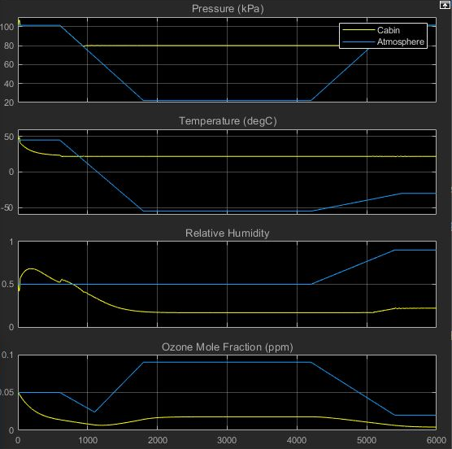
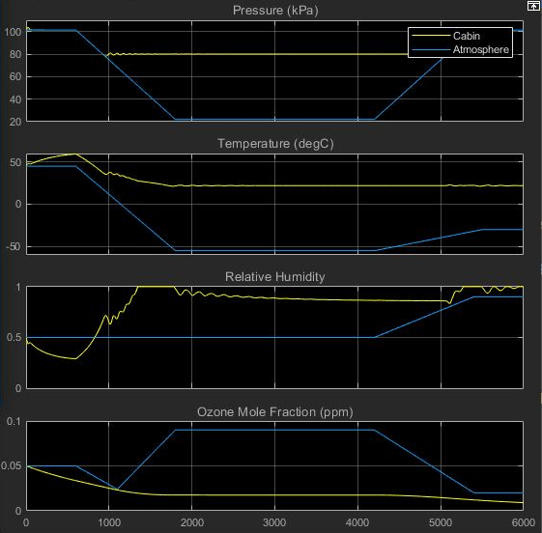
Change in cabin parameters due to variation in flow rate
Scale,
X-axis:
1 unit = 1000 seconds
Y-axis :
1 unit = 1 units of signal
Signals
Time (Seconds)
Fig. ECS parameter for Normal ventilation efficiency inside cabin
Fig. ECS parameter for Anomalous ventilation efficiency inside cabin

Slide 3

Neural Network augmented Control system
CLASS | DESCRIPTION | CONTROL ACTION
0 | No anomaly
1 | Ventilation Efficiency
2 | Internal Independent source
3 | External event
4 | Normal Conditions being restored
Temperature | Pressure | Humidity | Passenger Count
CO₂ across zones (1:6) | Rate of CO2 rise (1:6) | Deviation of zone from mean (1:6)
Neural Network
Input Parameters For The Neural Network
Output Of The NN
Class0 Class1 Class2 Class3 Class4
The neural net has 22 input and 5 output neurons
There are “X” hidden layers with “Y” neurons in each
332402 data frames are used for training and validation
The frame rate is 1/Sec and a total of 92 hrs of flight data is used for training and validation
A 70/30 training validation split is used
Confusion Matrix

Slide 4
Neural Network augmented Control system

